Slide 2
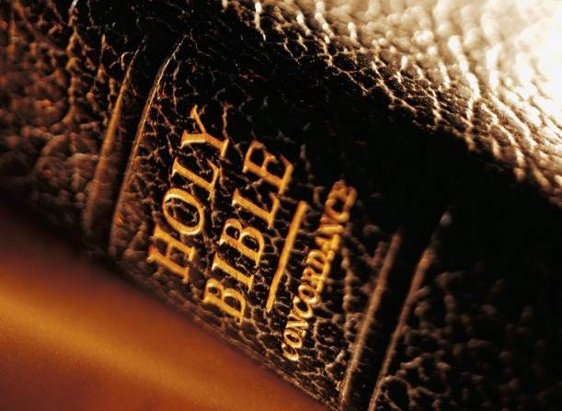
The Glory of God (John 1.14-18)
Now the Word became flesh and tabernacled among us, and we saw his glory, as the glory of the one and only son from the Father, glory full of grace and truth. ¹⁵ John testified about him and shouted out, “This was the one about whom I said, ‘He who comes after me is before me in rank, because he existed before me in time.’” ¹⁶ For of his fullness we have all received grace to replace grace. ¹⁷ For the law was given through Moses, but grace and truth came about through Jesus Christ. ¹⁸ No one has seen God at any time. The only son, himself God, the one being in the bosom of the Father, has revealed Him.
The Real Glory of God (John 1.14-18)

Slide 3
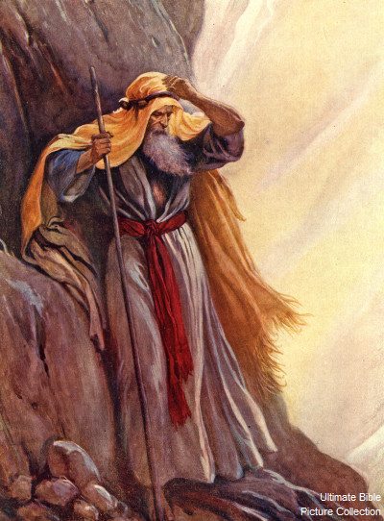
Exodus 33-34
none has “seen God” (1.18)
Jesus > Moses (1.17)
“grace ‘instead of’ grace” (1.16)
“tabernacled among us” (1.14)
“explained” the Father (1.18)
“we beheld his glory” (1.14)
“full of grace and truth” (1.14)
The Real Glory of God (John 1.14-18)

Slide 4
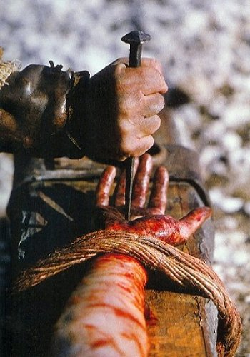
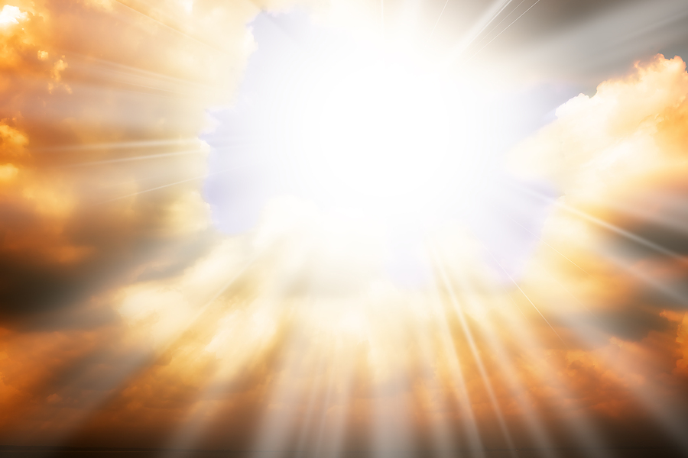
The glory of God...
do we see it in Jesus?
do others see it in us?
The Real Glory of God (John 1.14-18)

