Slide 2
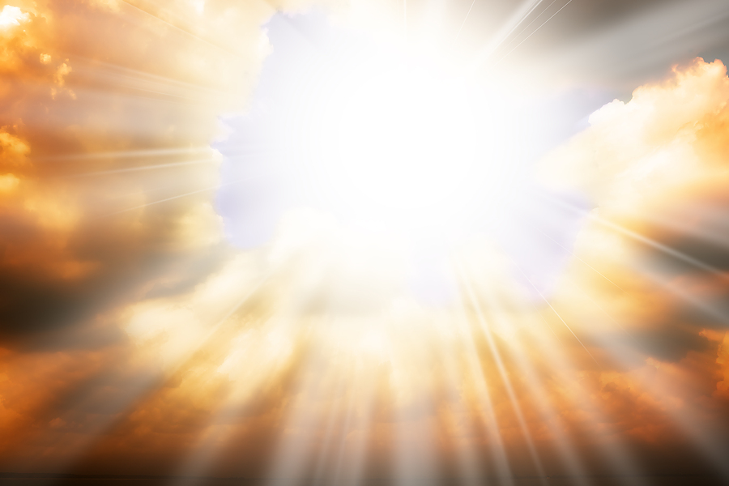
What is true holiness?
what message have you heard?
what kind of rock are you?
have you really seen God?
conviction
confession
consecration
commission
A simple syllogism:
I must be holy.
This world is unholy.
I must get away from this world.

